Slide 1

Project Management Web Application for Students
Godson Ozioma
AGE488
00592925
Supervised by Stefan Pletschacher and Shadab Mashuk

Slide 2
BACKGROUND
Managing projects and deadlines can be time-consuming and stressful for students.
Project management applications play a major role in the academic life of students.

Slide 3
AIM To develop a user-friendly web application to help students organize, track and manage their projects and deadlines.
OBJECTIVES
Explore the various programming languages and libraries used to develop a full-stack responsive web application and pick the best for this project.
Design a form system for authenticating users to log in and sign up securely.
Enable users to create, view and manage their projects and tasks.
Enable users to create teams.
Enable role hierarchy to give a user a team leader role and let the team leader add members to the team and create team projects.
Design a communication system to allow team members to send and receive messages.

Slide 4
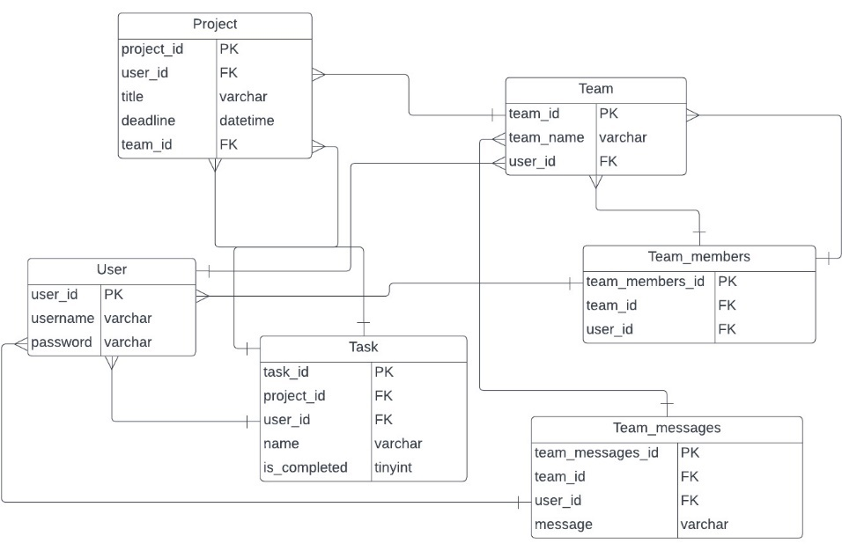
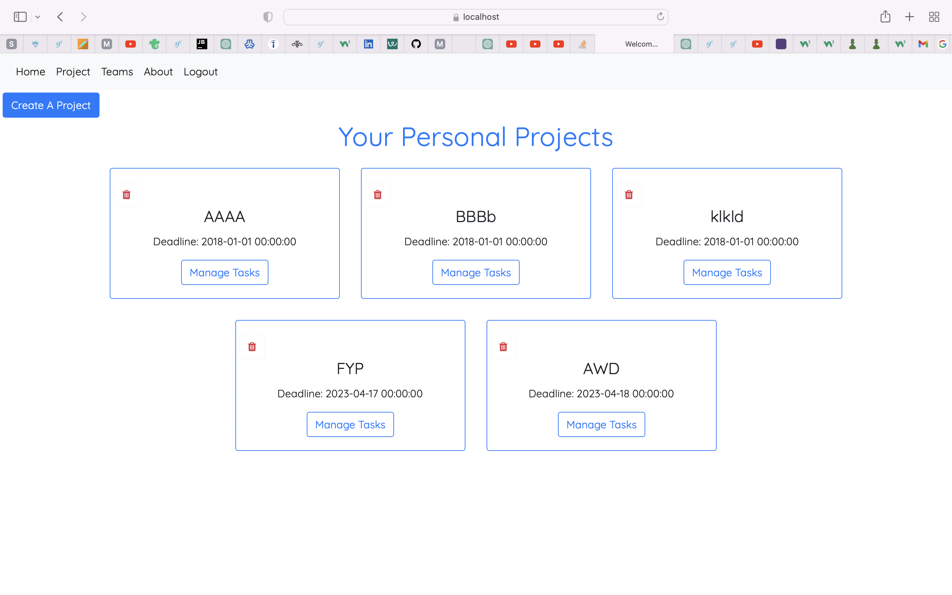
DESIGN

Slide 5
DEVELOPMENT
Agile methodology was implemented
Requirements development was split into 3 sprints.
Testing was done at the end of each sprint to get user feedback and ensure the system functions perfectly.

Slide 6
FEATURES
PERSONAL
Create Project
Add Task
Edit Task
Mark completed Tasks
Delete Project and Task
TEAM
Create Team
Live Search for Team members
Add members to the team
Live Chat with Team Members
Manage team projects and tasks
Leave Team

Slide 7
TESTING
Functional Testing
Security Testing
Performance Testing
Browser and Platform Testing
Acceptance Testing

Slide 8

LESSON LEARNT
Project planning using Agile methodology
Time management
Importance of Testing
PHP framework - Symfony

Slide 9

CONCLUSION
Fully functional project management application
Core Objectives successfully completed
User Satisfaction Guaranteed
Programming skills improved
Ready for Career in Software Engineering

